Slide 1
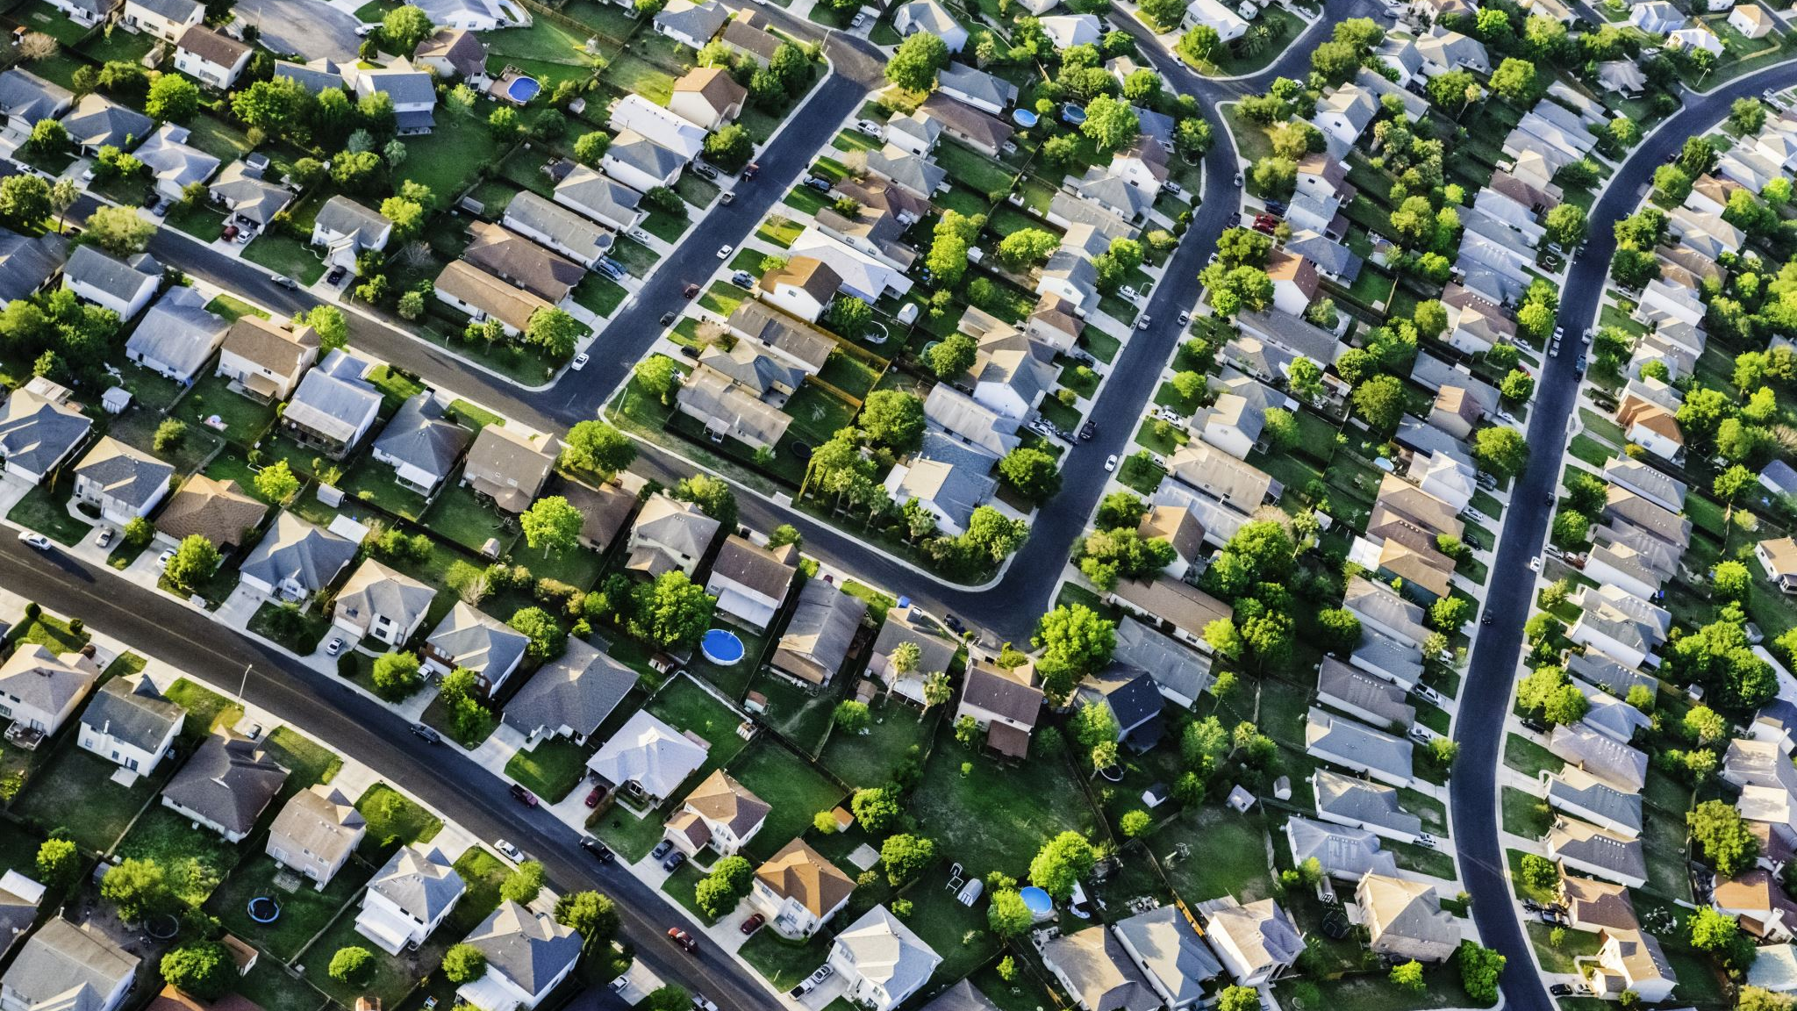
The Housing market: An In-Depth Analysis of the Los Angeles, Bay Area, and Las Vegas housing markets
By Michael Diaz, Sergio Basurto, and Osamu Adler

Slide 2
Bubble or Ever-Increasing Market?
-The past 15 years has presented a challenge for home-buyers as rising interest rates, two extreme economic recessions, quantative easing, the rise of investment bank ownership of single-family homes, and an increasing demand for homes has created a compounding issue
- Our analysis looks at data from the past few years of housing data in Los Angeles, the Bay Area, and Las Vegas (Clark) county

Slide 3


Where we Got our Data:
Our group connected our project to both the Zillow and Census Bureau API’s to extract our data for LA, Las Vegas, and the Bay Area
Using this data we were able to build graphs and tables to show our findings

Slide 4
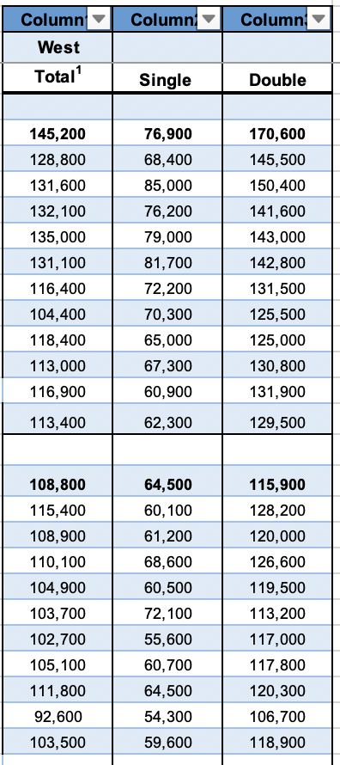
The past year: Average Sales Price of New homes (West Coast as a Whole)
This table shows the average sales price of all West Coast homes in 2022 including apartments, the average price has spiked between 30-50k in one year depending on the size of the home. This is a worrying trend.

Slide 5
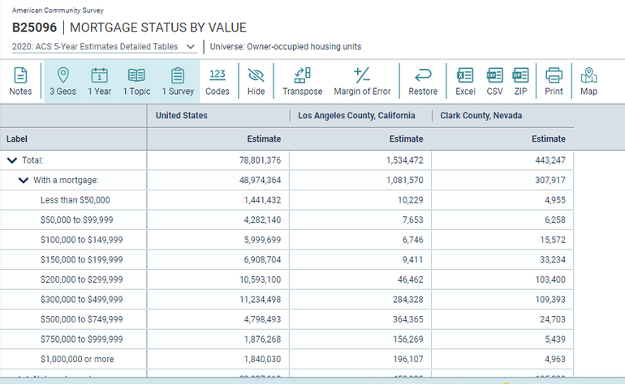
The most recent data: A comparison
-
The graph above demonstrates that the average mortgage value has increased dramatically in the past 3 years.

Slide 6
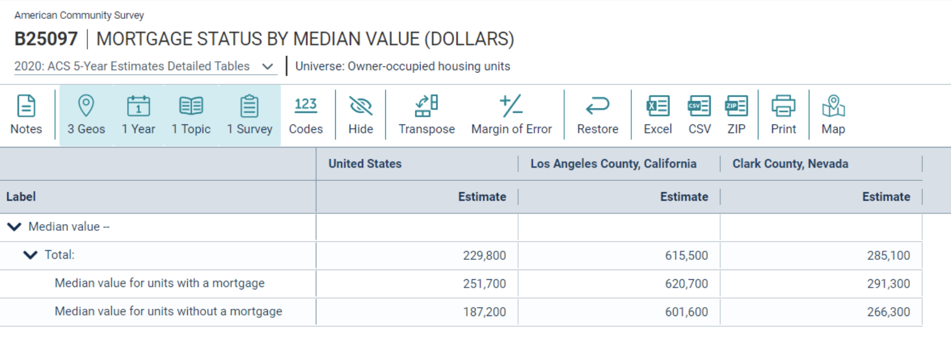
The Us vs our Two counties

Slide 7
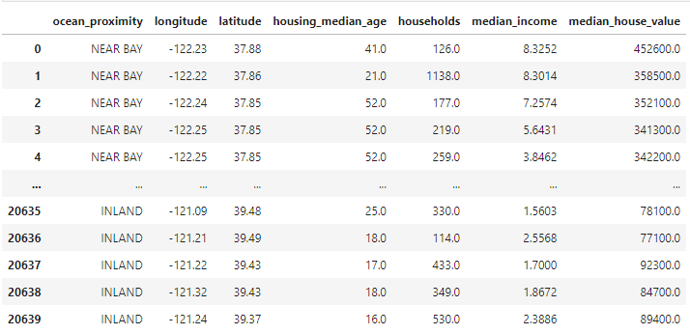
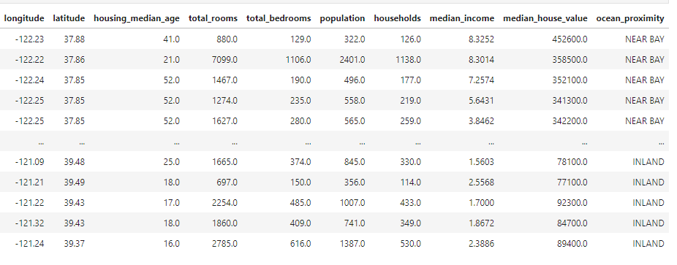
LA Price Comparison
These two graphs showcase LA and the Bay area as a comparison of a few different factors.

Slide 8
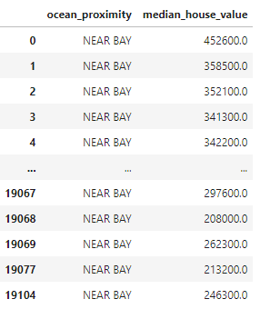
Bay Area Price Comparison Cont.

Slide 9
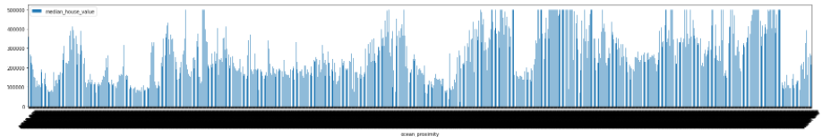
LA Current Pricing (2006-2022)
2007 low
2020 low
Despite the economic recession of 2007 and the subsequent housing crash due to the Covid outbreak in 2020,
this graph shows the continuing and worrying trend that the housing market has continued to spike throughout the years.

Slide 10
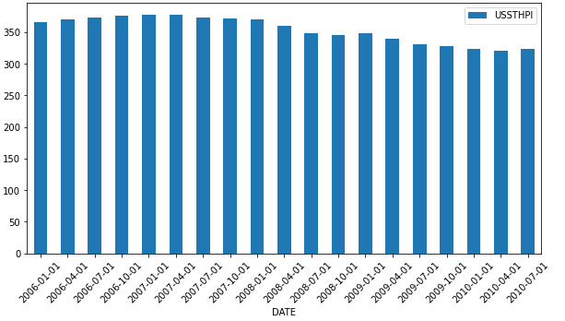
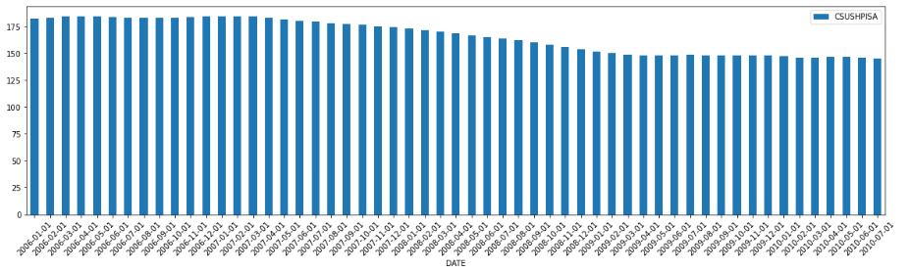
LA Price Drop Cont…

Slide 11
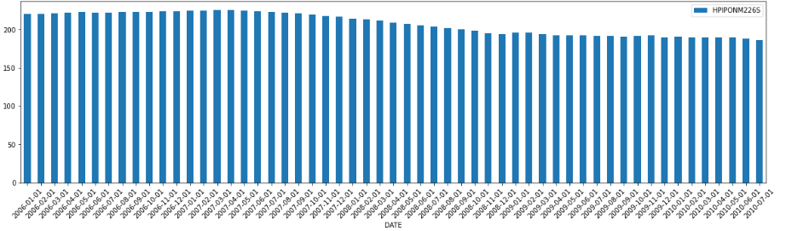
Although this graph shows a slight decrease between 2007 and 2010 due to economic downturn, the importance of this information demonstrates that the housing market is a strong representative of market cycles and the overall health of the economy

Slide 12
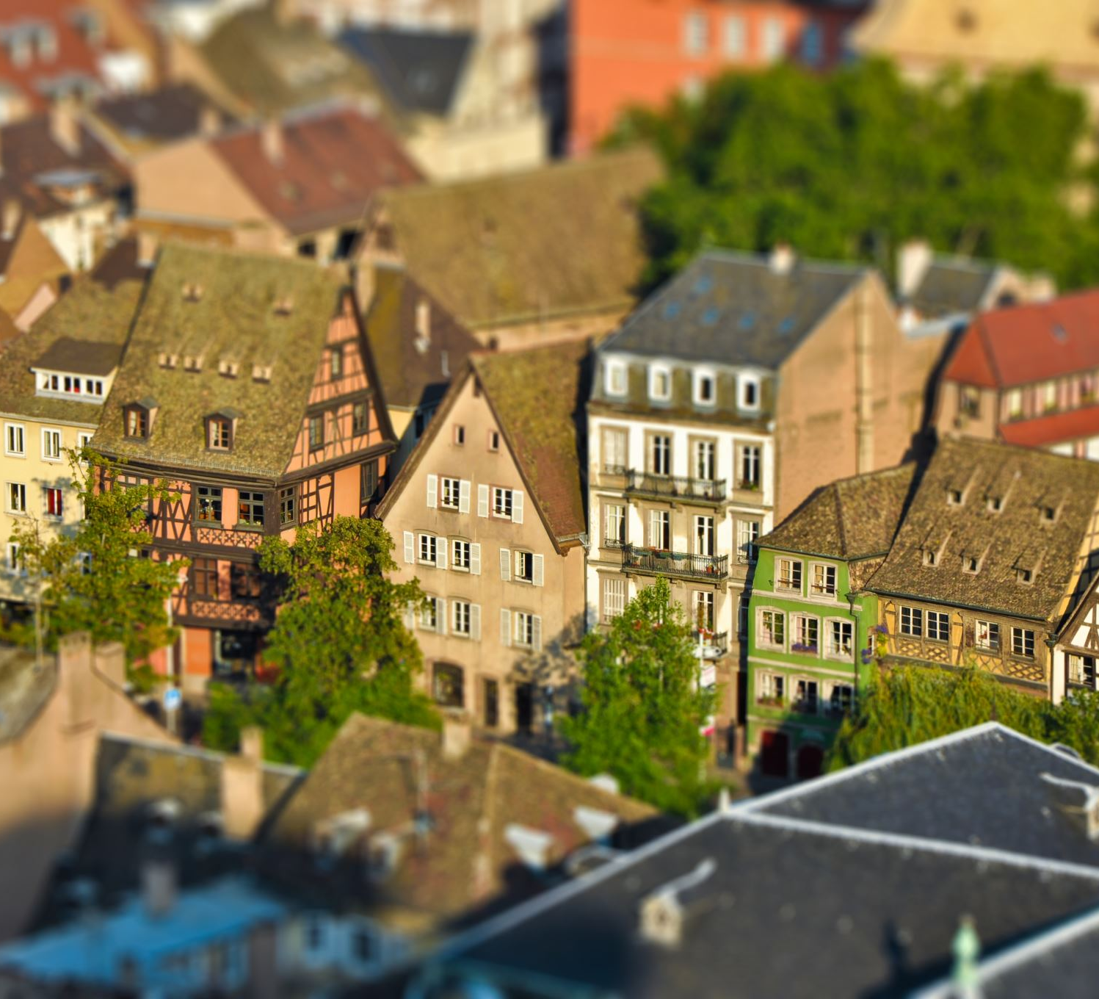
Conclusions:
Based on our findings, the housing market has expanded greatly in the past few years and will continue to grow quickly.
Due to the cyclical cycle and rapid population growth in all three of these cities throughout the past 15 years, although there have been slight dips in the markets at points, the overall market has continued to expand at a rapid pace with these concerning results of these rising prices to be determined.

